Slide 1
IBM University Engagement Project Submission
The AI-Powered Municipal Solid Waste & Circular Economy Platform explores the capabilities of Agentic AI

Slide 2

Project Tile – AI-Powered Municipal Solid Waste & Circular Economy Platform
Domain of Project – Agriculture /Municipal Solid Waste Management & Circular Economy
Student Name | Recent Passport Photo | Email ID | Mobile number
Anjara chhaya vinodbhai |  | anjarachhaya64@gmail.com | 9313771754

Slide 3
Problem Statement -
Problem Statement : AI-Powered Municipal Solid Waste & Circular Economy Agent
The Challenge
Municipal corporations face challenges in waste management due to poor waste segregation, delayed complaint resolution, inefficient collection, and limited public awareness. Citizens also lack a reliable platform to report waste issues and receive proper guidance.
The Objective
Develop an AI-powered platform that enables smart complaint management, AI-based citizen assistance, waste classification, recycling guidance, and analytics to improve municipal waste management and support a sustainable circular economy.
Multi-Agent System
Citizen Support Agent – Assists users with waste-related queries, complaint registration, and municipal service information.
Complaint Management Agent – Manages complaint creation, tracking, assignment, and status updates.
Waste Classification Agent – Identifies waste categories from uploaded images and provides disposal recommendations.
Recycling & Circular Economy Agent – Recommends recycling methods, waste reduction strategies, and sustainable practices.
Municipal Analytics Agent – Generates dashboards, reports, and actionable insights for municipal officers and administrators.

Slide 4
Proposed Solution -
Proposed Solution: AI-Powered Municipal Solid Waste & Circular Economy Platform
The proposed solution is a multi-agent AI-powered Municipal Solid Waste & Circular Economy Platform built using Flask, IBM Granite AI, SQLite, Bootstrap, and IBM watsonx.ai to improve urban waste management, complaint handling, and citizen engagement. The platform provides an intelligent and centralized solution for citizens and municipal authorities through an AI-driven, modular architecture.
At its core, the platform integrates an AI Citizen Assistant powered by IBM Granite models to provide real-time guidance on waste segregation, recycling methods, complaint registration, and municipal services. The system is designed to support future Retrieval-Augmented Generation (RAG) integration, enabling accurate responses using trusted municipal policies, waste management guidelines, and environmental knowledge bases.
The system consists of four key agents:
Citizen Support Agent assists users with waste-related queries, complaint registration, complaint tracking, and municipal service information using AI-powered conversations.
Complaint Management Agent manages complaint submission, tracking, assignment, and status updates, enabling efficient communication between citizens and municipal officers.
Waste Classification Agent analyzes uploaded waste images and identifies waste categories such as wet waste, dry waste, plastic waste, and e-waste while providing appropriate disposal and recycling guidance.
Municipal Analytics Agent generates dashboards, complaint statistics, waste trends, and operational insights to support data-driven decision-making for municipal authorities.
The solution includes a responsive web dashboard built with Flask, Bootstrap 5, HTML, CSS, and JavaScript, allowing citizens to submit complaints, interact with the AI Assistant, and access waste management services, while administrators and municipal officers can monitor complaints, analyze trends, and manage operations efficiently.

Slide 5
Technology Used
Category | Technology
Programming Language | Python 3.13
Backend Framework | Flask
Frontend | HTML5, CSS3, JavaScript
UI Framework | Bootstrap 5.3
Database | SQLite (SQLAlchemy)
AI / LLM Technology | IBM Granite AI Model
AI Platform | IBM watsonx.ai
AI Approach | Agentic AI
Configuration | Environment Variables (.env)

Slide 6
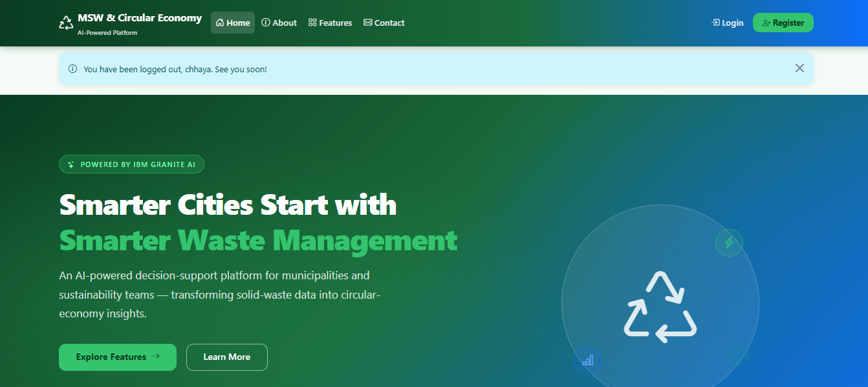

Slide 7
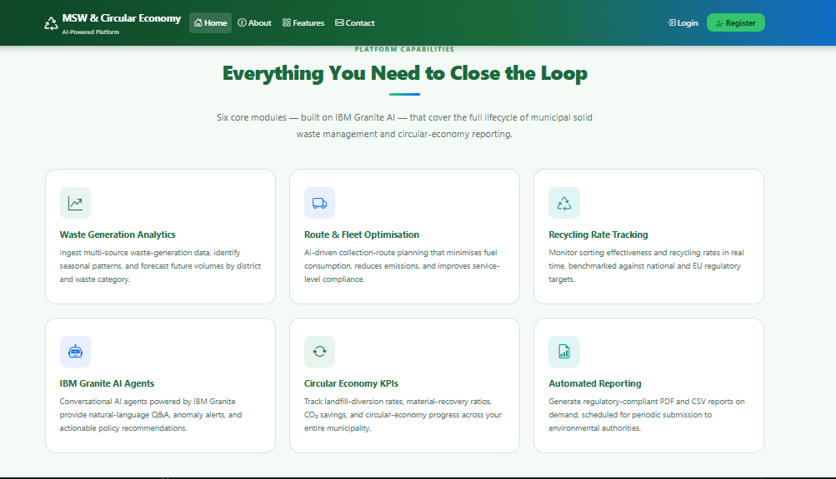
Feature page

Slide 8
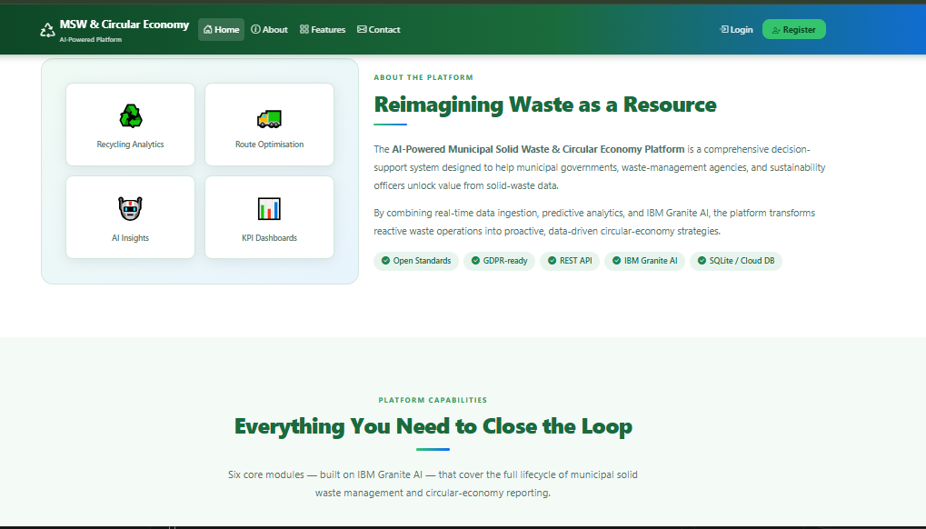
About Page

Slide 9
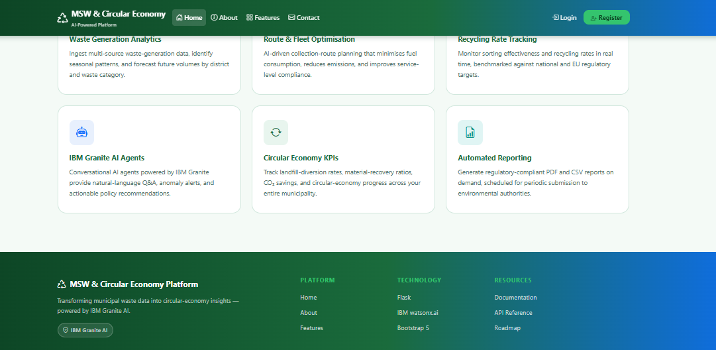

Slide 10
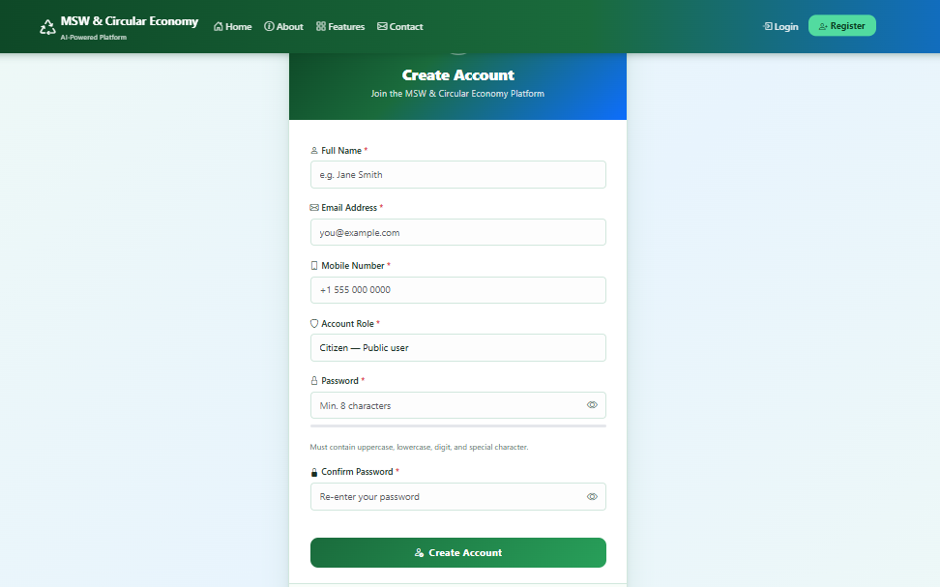
Admin Login,citizen and municipal officers can register and login to access their respective pages

Slide 11
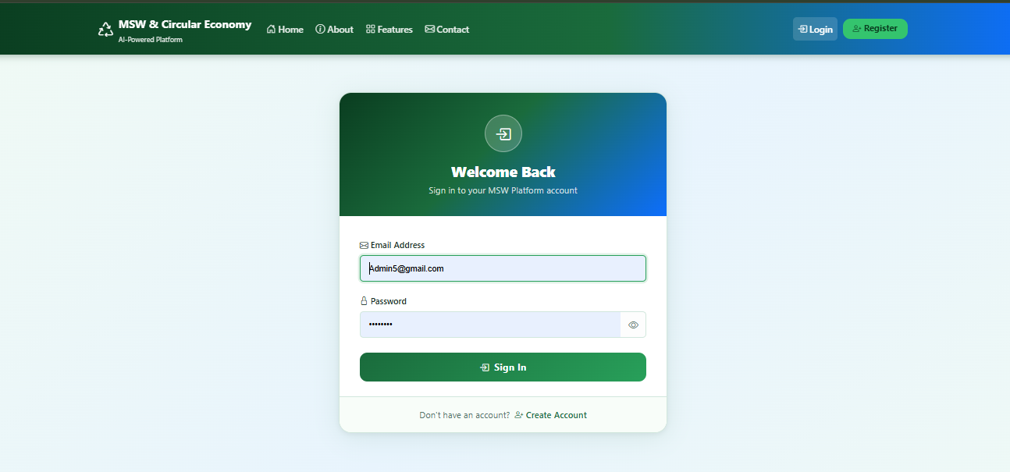
Admin Login,citizen and municipal officers can register and login to access their respective pages

Slide 12
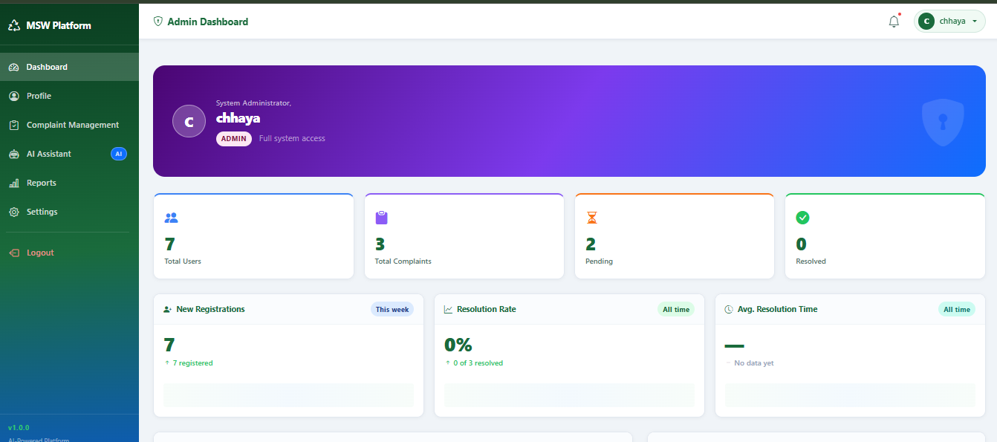
Admin can login and access their dashboard

Slide 13
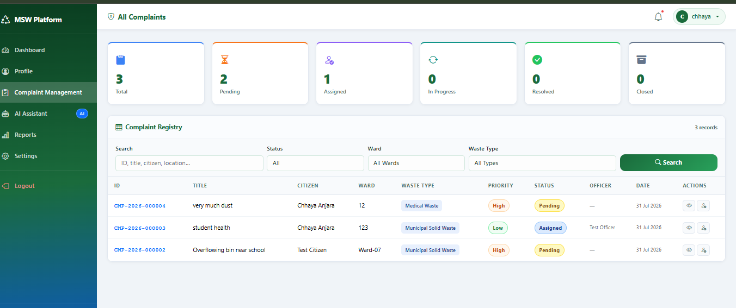

Slide 14
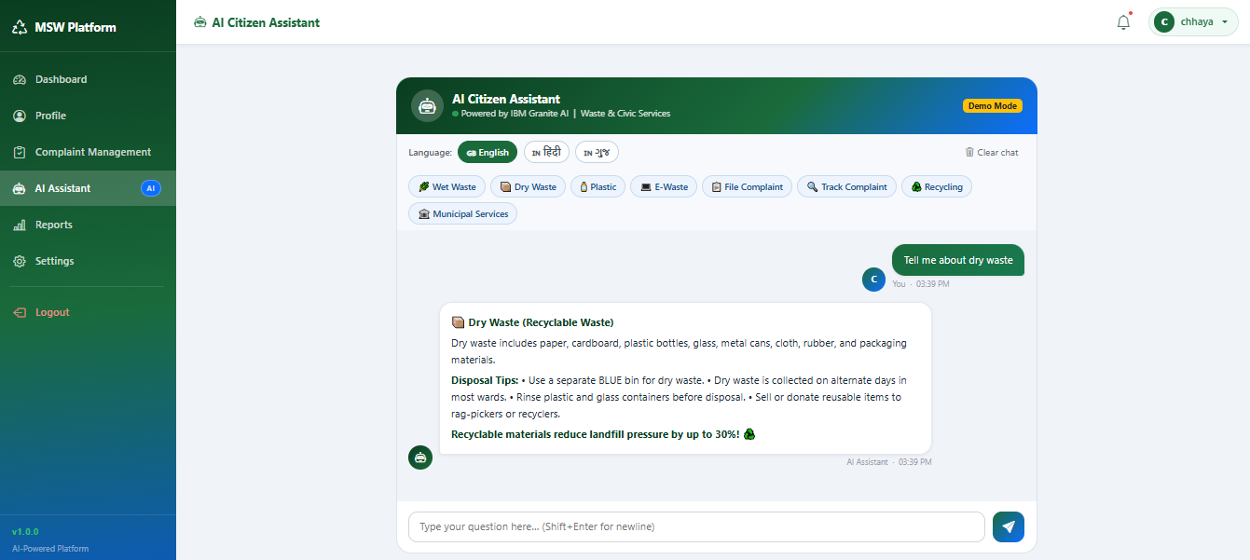
Ai Agent

Slide 15
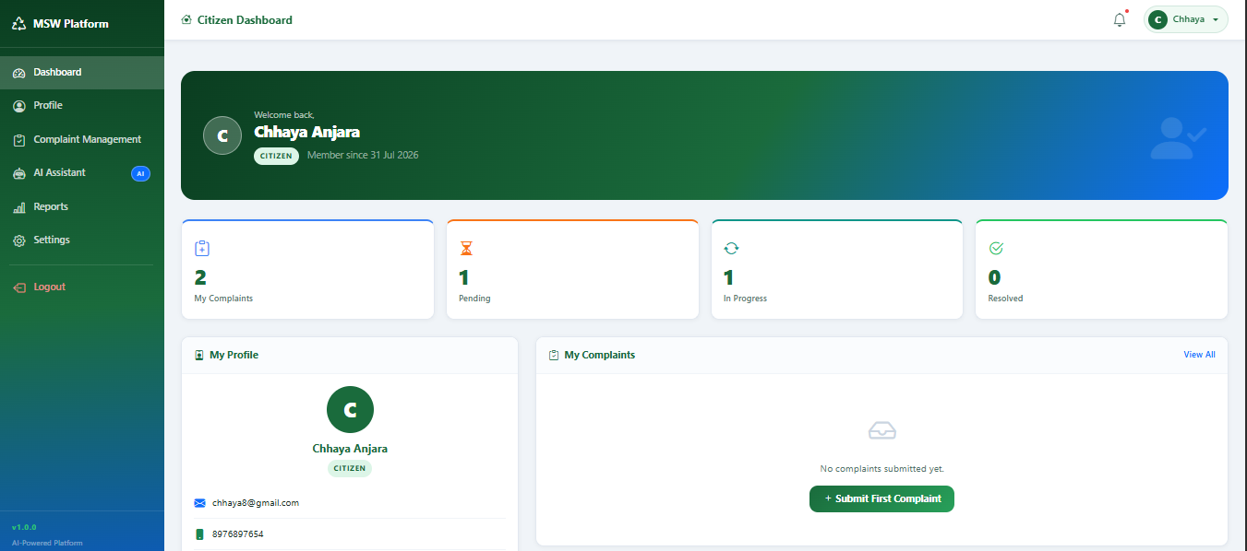
Citizen can login

Slide 16
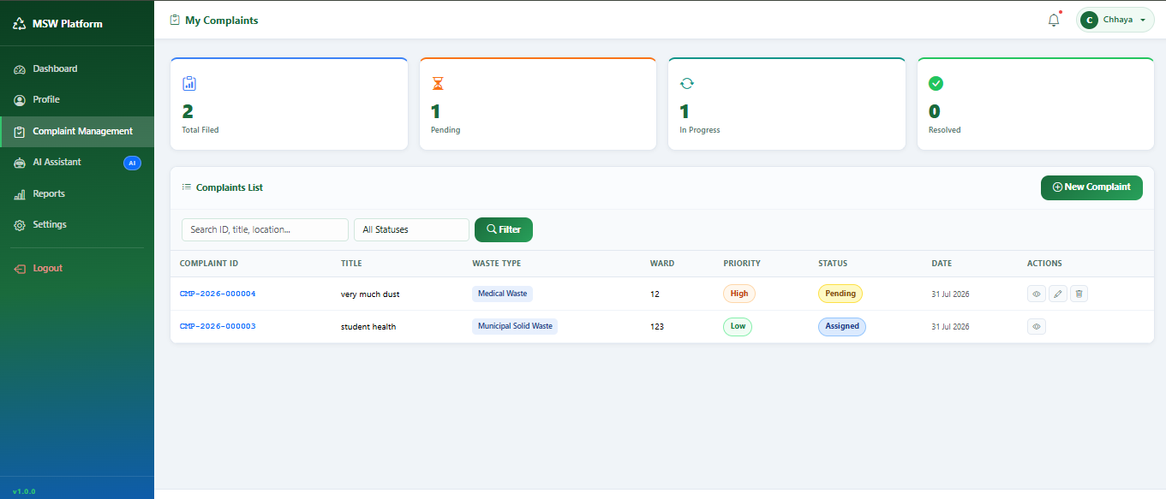
Citizen complaints

Slide 17
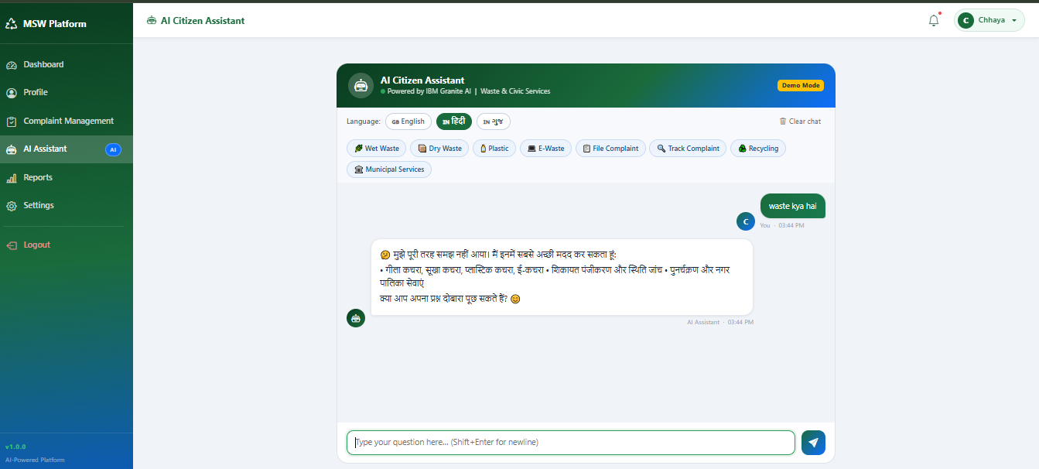
Citizen Ai Agent in Hindi

Slide 18
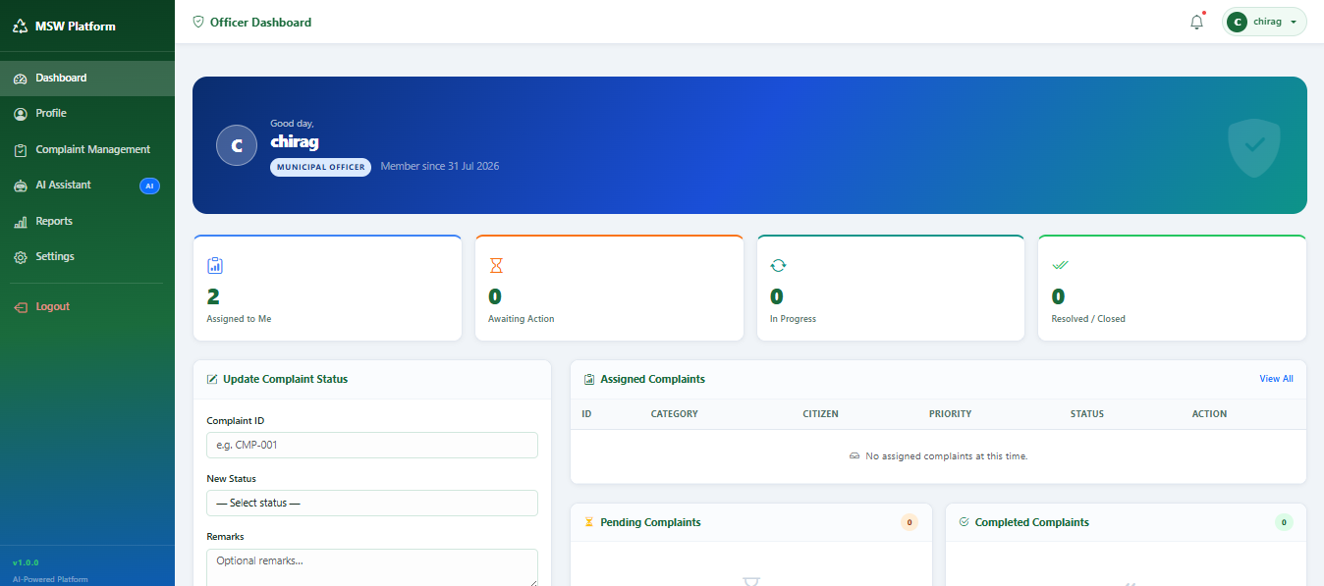
Muncipal Officer can Login and view/manage citizen compaints

Slide 19
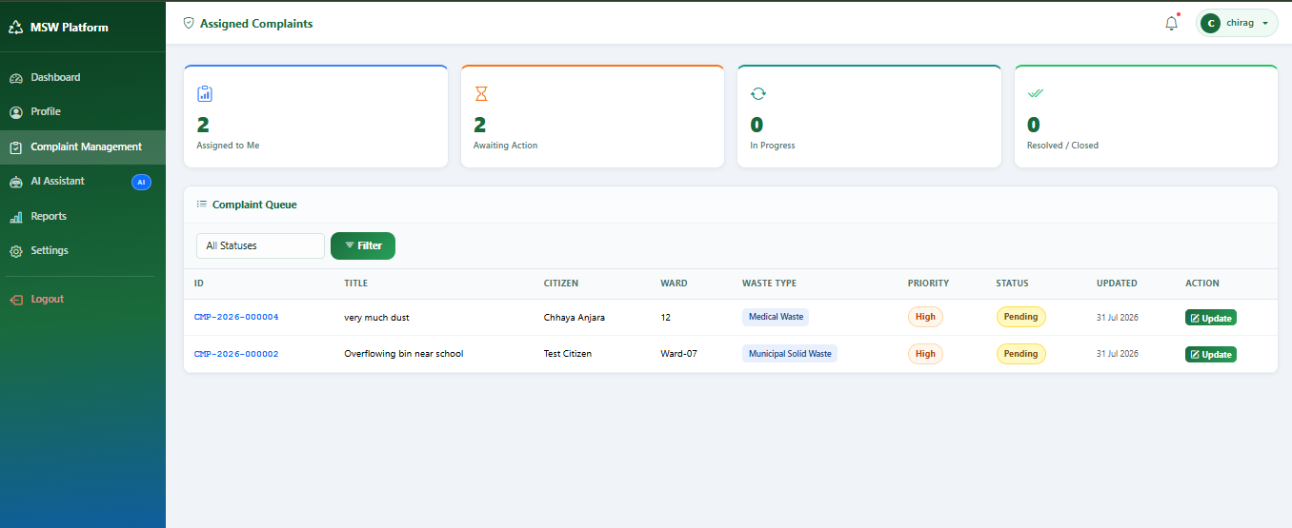
Assigned Compaints from citizen

Slide 20
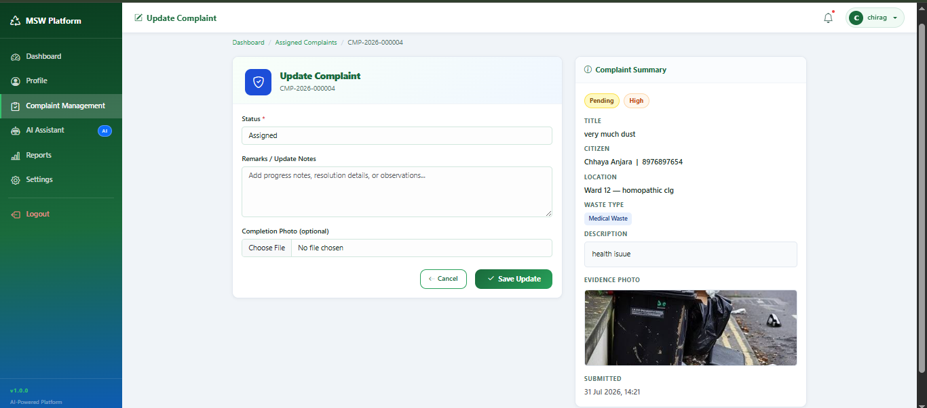
Citizen can update their compaints

Slide 21
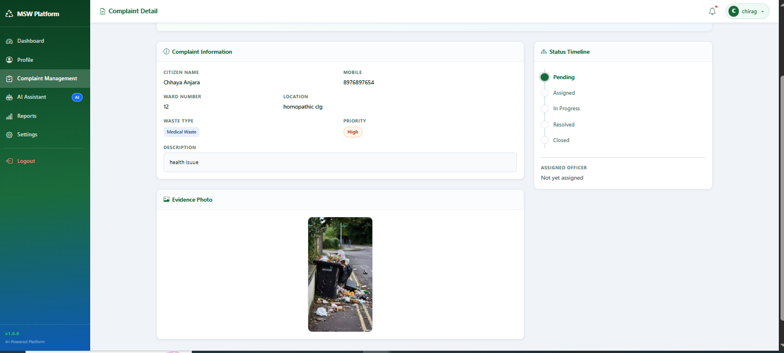
Admin can view complaint details

Slide 22
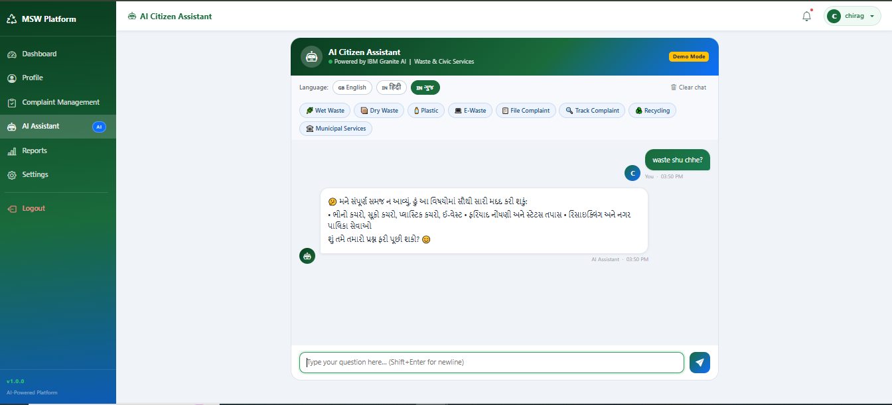
Ai Agent in Gujarati

Slide 23

Role of Agentic AI in the solution
Agentic AI plays an important role in making the municipal solid waste management system intelligent, automated, and decision-driven. It enables AI agents to analyze waste-related data, understand problems, and provide recommendations for improving waste management operations.
In this project, Agentic AI helps municipalities by:
Intelligent Waste Analysis: AI agents analyze waste generation patterns and provide insights for better waste management planning.
Smart Decision Support: Agentic AI assists municipal teams by generating AI-based recommendations for collection planning, resource utilization, and sustainability improvements.
Collection Optimization: AI agents help identify efficient waste collection strategies by analyzing available data and improving operational efficiency.
Circular Economy Support: Agentic AI helps track sustainability-related information and provides suggestions to improve recycling and resource recovery practices.
Automated Assistance: AI agents can respond to waste management queries and support users with relevant information and recommendations.
Overall, Agentic AI transforms traditional waste management into a smarter, data-driven, and sustainable system by enabling autonomous analysis, decision support, and continuous improvement.

Slide 24
Git Hub Link
https://github.com/ANJARA05/AI-Powered-Municipal-Solid-Waste-Circular-Economy-Platform
·
·
·

Slide 25
Future Scope
The future scope of the AI-Powered Municipal Solid Waste & Circular Economy Platform is to enhance the system with more advanced Artificial Intelligence capabilities and real-time smart city integration. The platform can be extended by integrating IoT sensors, GPS-based tracking, and real-time waste monitoring systems to collect accurate field data.
In the future, AI agents can be improved to provide more accurate waste collection predictions, dynamic route optimization, and automated decision-making for municipal authorities. The system can also be integrated with mobile applications to improve citizen participation through complaint reporting, waste segregation guidance, and awareness programs.
The platform can further support advanced analytics, predictive modeling, and sustainability reporting to help municipalities reduce waste generation, increase recycling efficiency, and achieve circular economy goals. Integration with smart city platforms and cloud-based services can make the solution scalable for large urban areas.
Overall, the future development of this platform focuses on creating a fully intelligent, automated, and sustainable waste management ecosystem using Artificial Intelligence and emerging technologies.
·
·
·

Slide 26
Certificates Earned:
Please add your credly certificate

Slide 27
Certificates Earned:​
Add your IBM BOB Certificate

Slide 28


